Slide 1


Anti-coordination idea on “Proving a phase transition in cellular automata under asynchronous dynamics”
Alireza Abrehforoush

Slide 2


Topics
Introduction
Polynomial convergence time

Slide 3
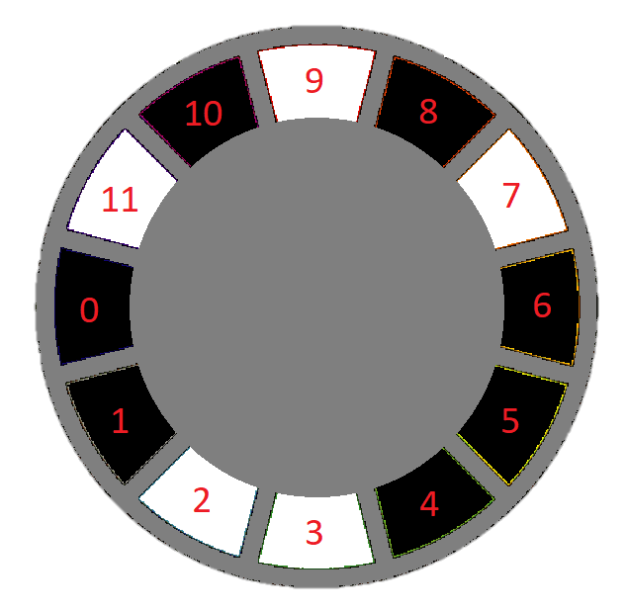


Introduction
Configuration

Slide 4
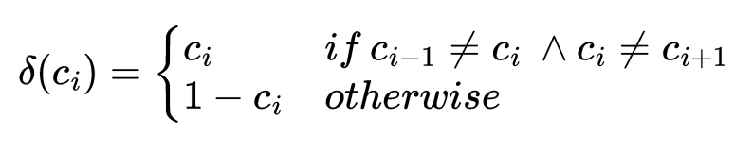
Introduction
FLIP_IF_EQUAL_TO_AT_LEAST_ONE_NEIGHBOR

Slide 5
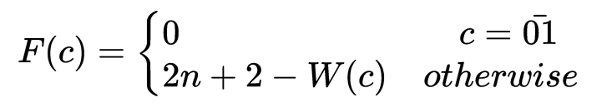
Polynomial convergence time
Potential function

Slide 6
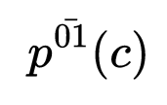
Polynomial convergence time
Probability of reaching to equilibrium in next step

Slide 7
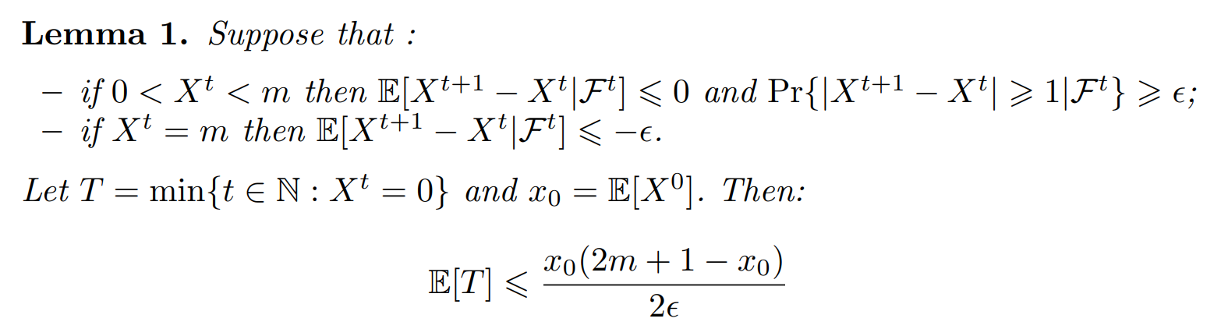
Polynomial convergence time
Lemma 1

Slide 8
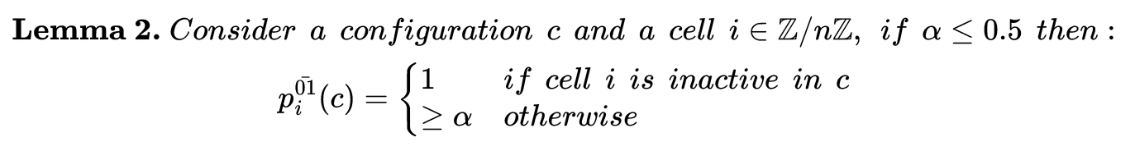
Polynomial convergence time
Lemma 2

Slide 9
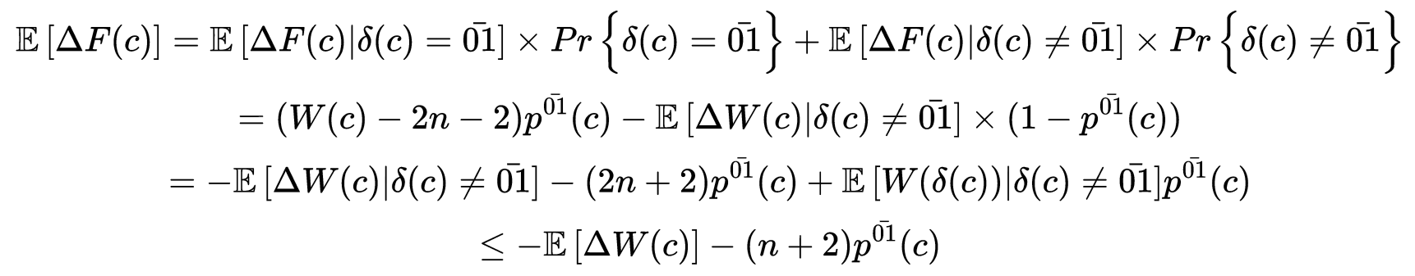
Polynomial convergence time
Expected value of potential function difference

Slide 10
Polynomial convergence time

Slide 11
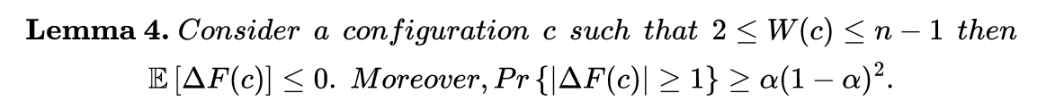
Polynomial convergence time

Slide 12
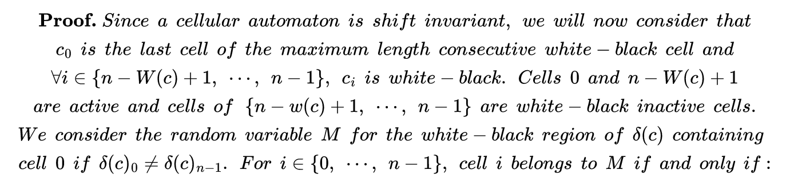

Polynomial convergence time

Slide 13
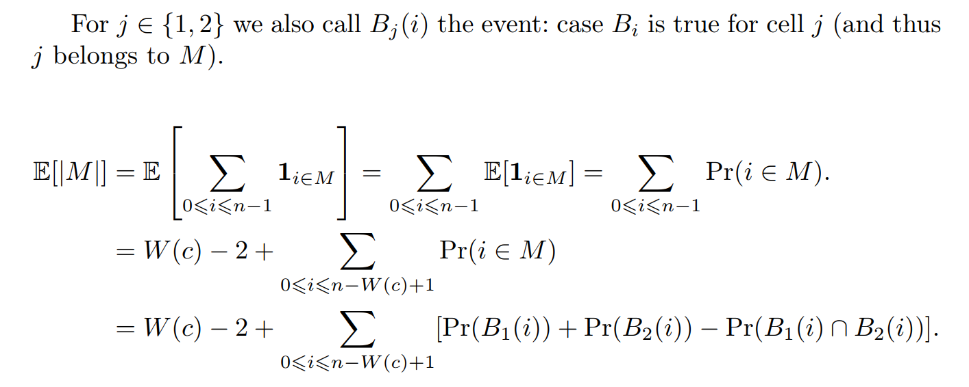
Polynomial convergence time

Slide 14
Polynomial convergence time

Slide 15
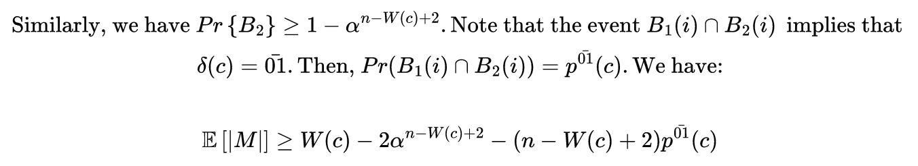
Polynomial convergence time

Slide 16
Polynomial convergence time

Slide 17
Polynomial convergence time

Slide 18
Polynomial convergence time

